Slide 1

STORE TRIAL ANALYSIS & CUSTOMER SEGMENTATION
June 2026
Prepared for Julia | Quantium Virtual Internship

Slide 2
EXECUTIVE SUMMARY
01
Task 1
• Mainstream Young Singles/Couples were the highest revenue-generating customer segment.
• Premium customers spent more per transaction than other customer groups.
• Customer demographics significantly influenced purchasing behaviour and sales performance.
02
Task 2
• Trial stores 77, 86 and 88 were compared against matched control stores.
• Store performance was evaluated using sales trends, customer counts and transactions per customer.
• Statistical testing identified differences in performance between trial and control stores.

Slide 3
01
CUSTOMER SEGMENTATION

Slide 4
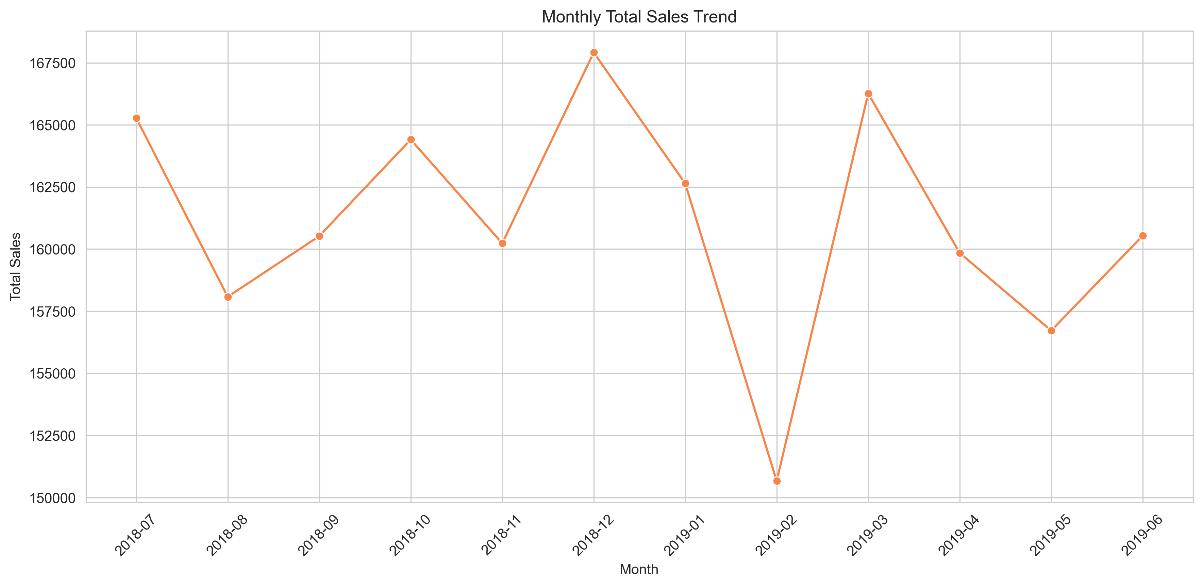
CATEGORY OVERVIEW
KEY INSIGHTS
Mainstream Young Singles/Couples generated the highest sales revenue.
Budget and Mainstream customers contributed the largest share of transactions.
Premium customer segments showed higher average spend per customer.

Slide 5
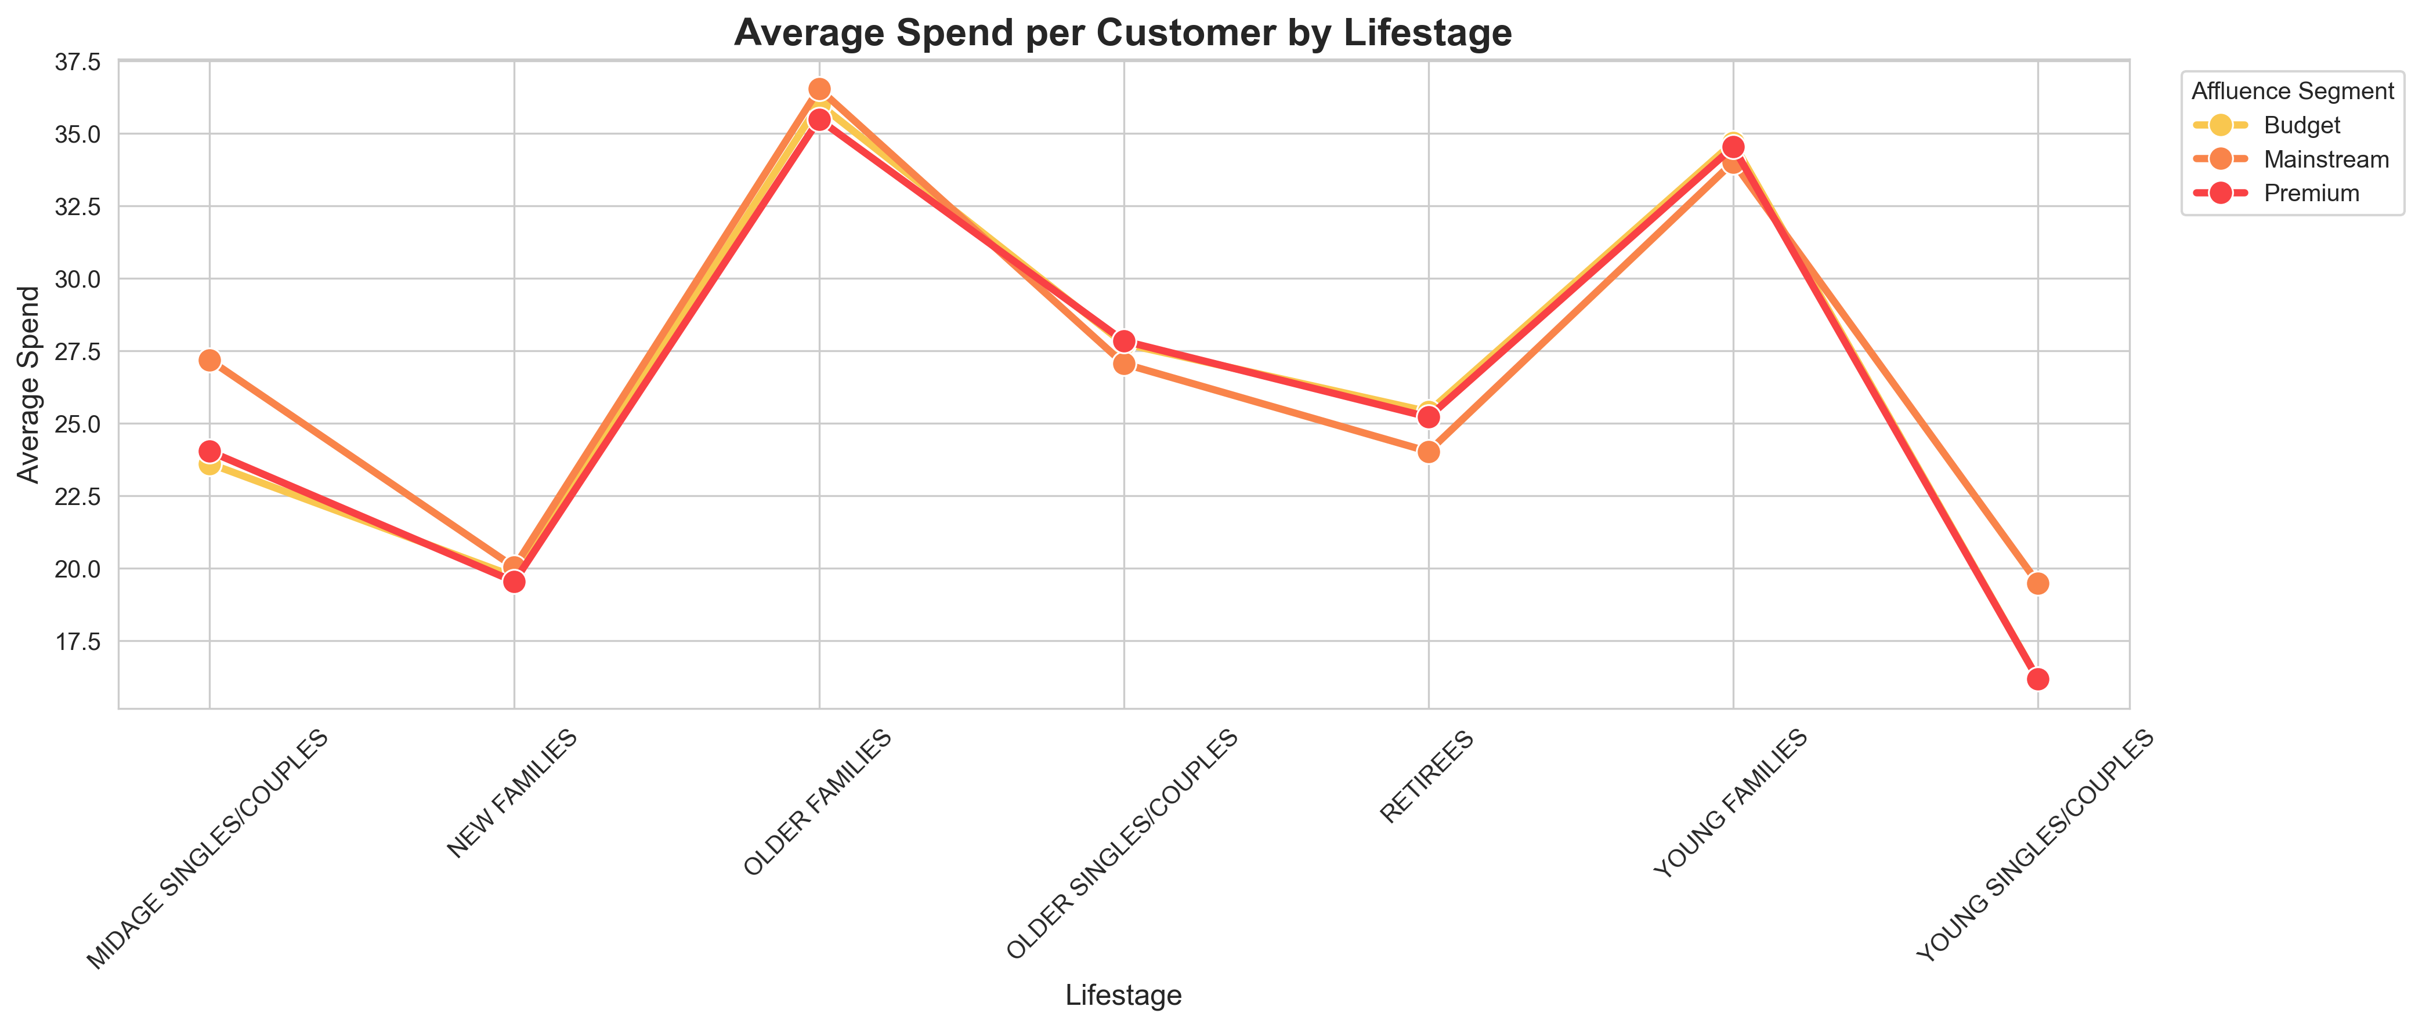
AFFLUENCE AND CONSUMER BUYING BEHAVIOUR
KEY INSIGHTS
Mainstream customers generated the largest
share of chip sales.
Premium customers recorded higher average
spending per transaction.
Budget customers contributed significantly to
purchase volume despite lower spending levels.
Purchasing behaviour differs across affluence
segments, indicating opportunities for targeted
Marketing.

Slide 6
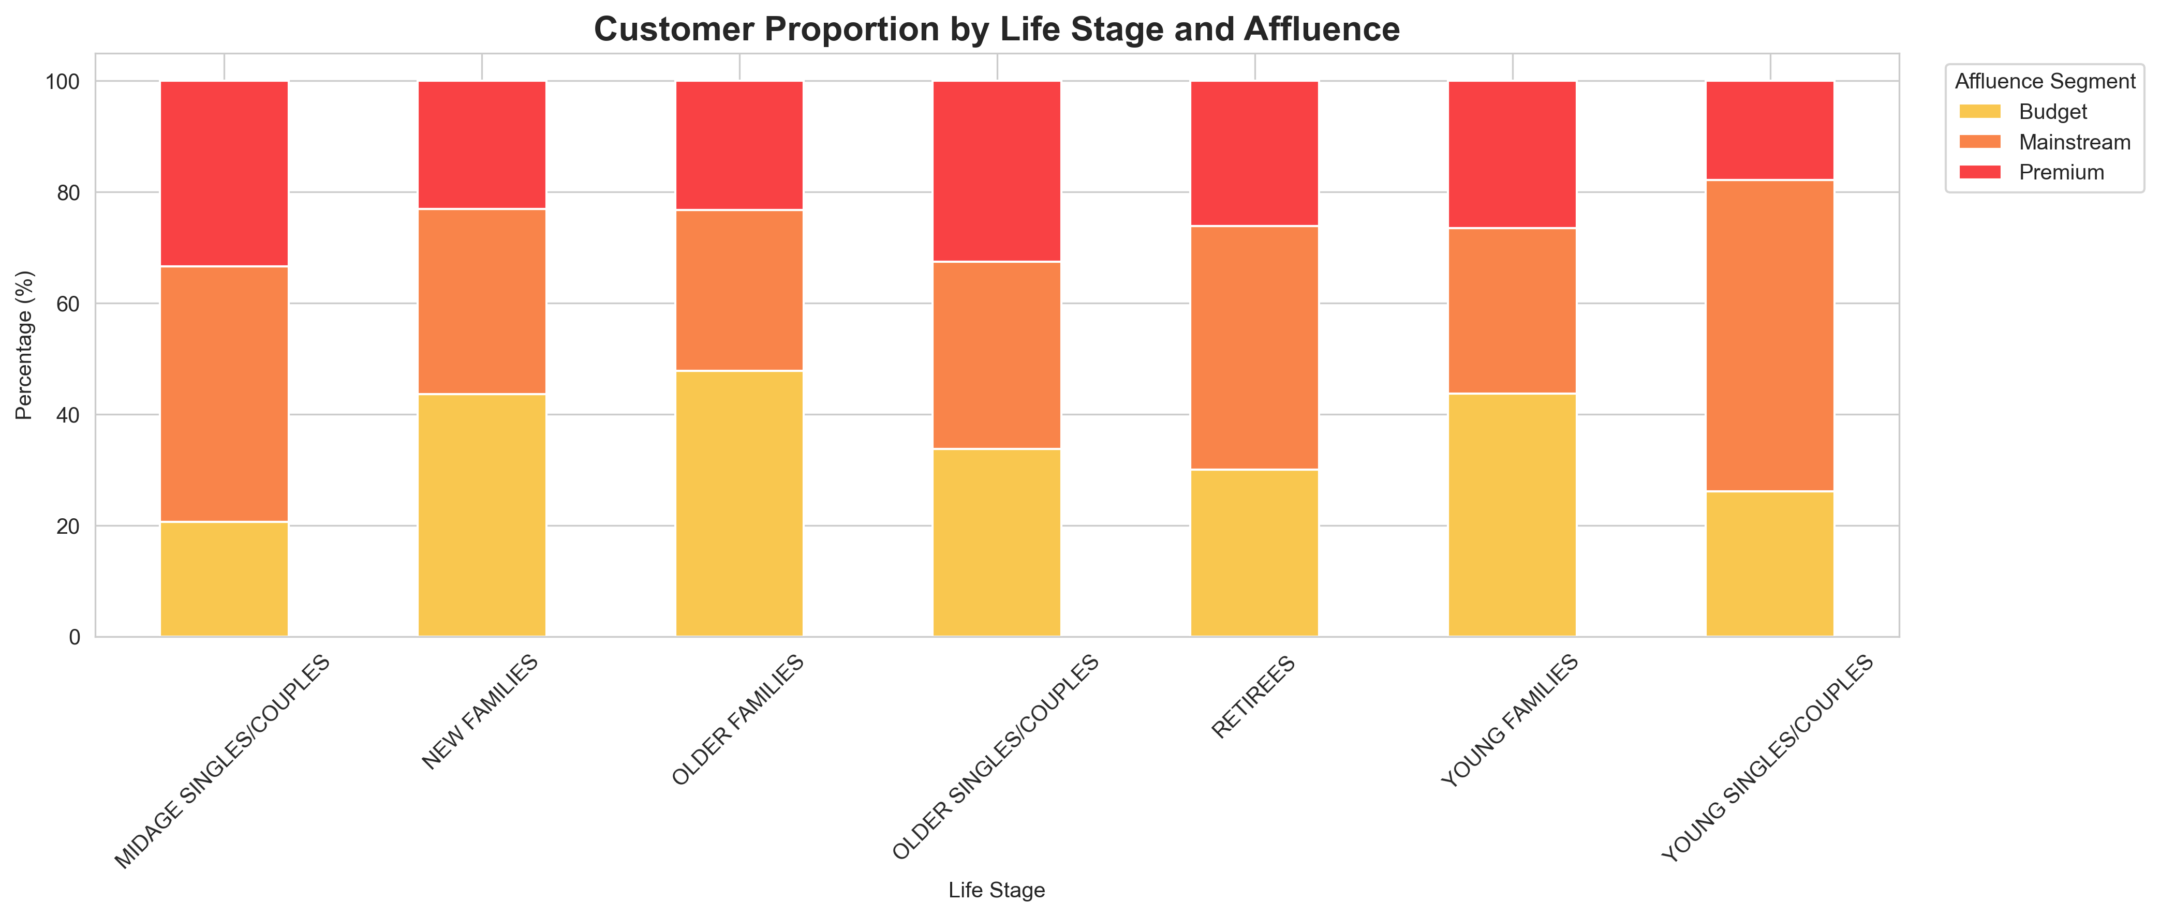
CUSTOMER PROPORTION BY LIFE STAGE AND AFFLUENCE
KEY INSIGHTS
Mainstream customers represent the
largest proportion across most life
stages.
Customer composition varies by life
stage and affluence segment.
Premium customers form a smaller
share but generally spend more per
customer.
Different customer groups may
require targeted marketing
approaches.

Slide 7
02
STORE TRIAL ANALYSIS

Slide 8
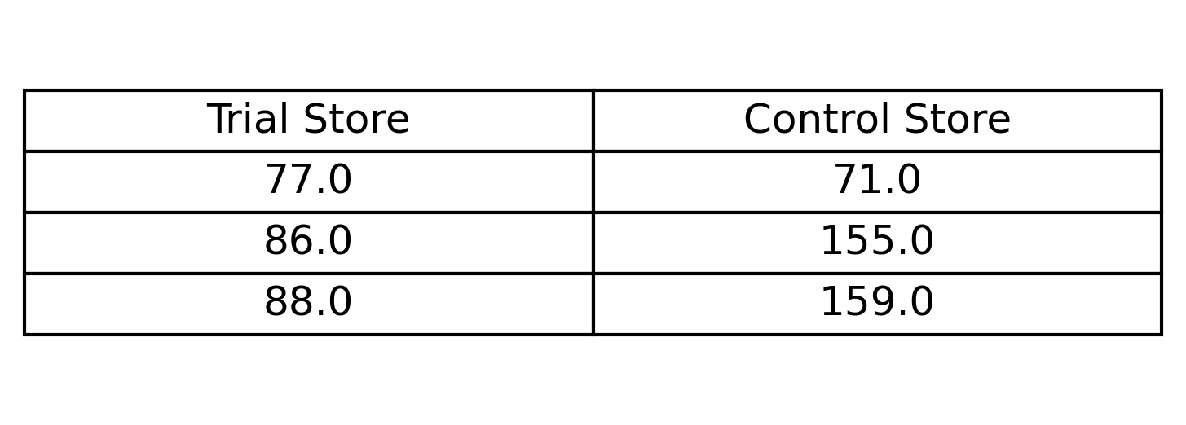
CONTROL STORE SELECTION METHODOLOGY
KEY INSIGHTS
Control stores were selected using Pearson correlation
during the pre-trial period.
Stores with similar sales patterns and customer behaviour
were chosen as controls.
Matching control stores provide a reliable benchmark for
evaluating trial performance.
This approach helps isolate the impact of the trial from
normal business variation.

Slide 9
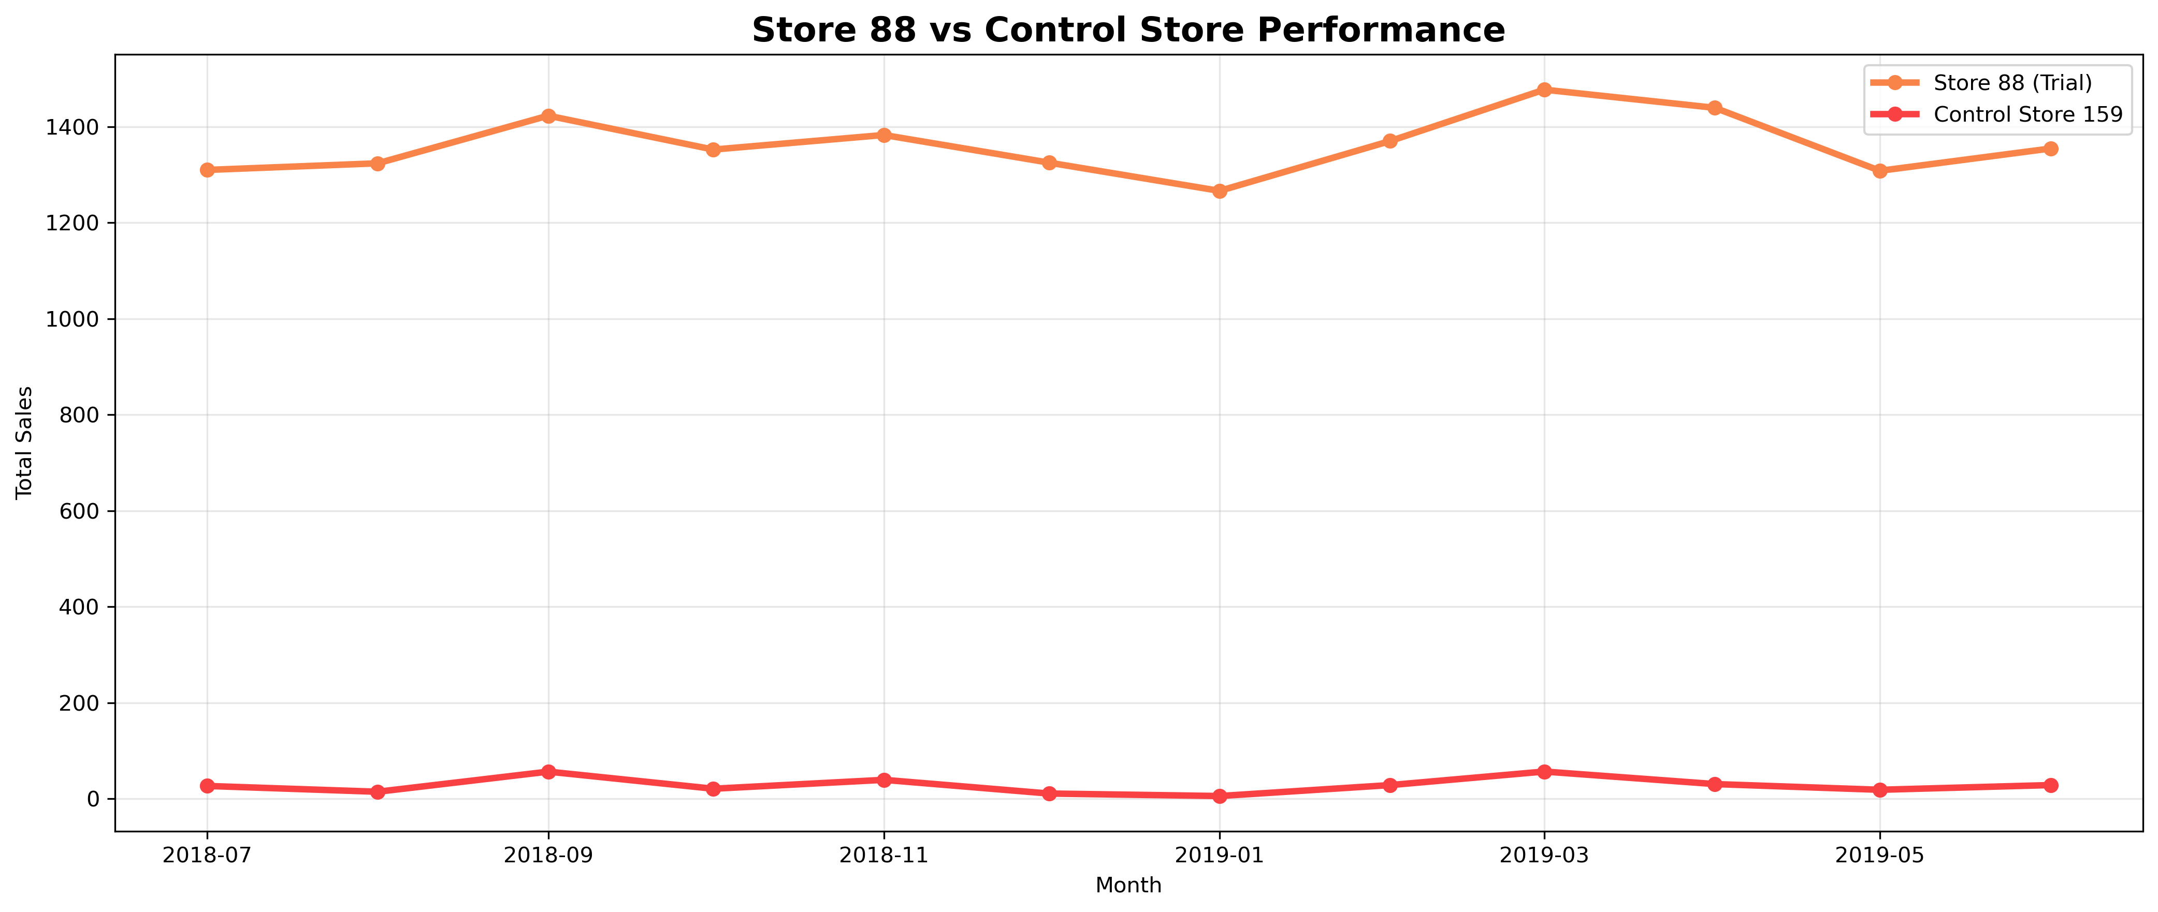
TRAIL STORE PERFORMANCE ASSESSMENT
KEY INSIGHTS
88 recorded substantially higher
sales than its control store.
The sales difference was statistically
significant.
The trial appears to have positively
influenced store performance.
Store 88 delivered the strongest trial
outcome among the three stores.

Slide 10
RECOMMENDATIONS
Expand successful strategies implemented in Store 88.
Continue monitoring Store 86 before wider rollout.
Review the factors contributing to Store 77's lower performance.
Improve future control-store selection using both correlation and sales
magnitude measures.
Continue tracking customer behaviour to support future trial programs.

Slide 11
CONCLUSION
Customer segmentation identified key revenue-driving customer groups.
Store trial analysis showed varying levels of success across trial stores.
Store 88 demonstrated the strongest positive trial outcome.
Findings provide valuable insights for future marketing and store strategies.

